Slide 1
Strategic Software
Product Management
Prof. Dr. Dirk Riehle
Friedrich-Alexander University Erlangen-Nürnberg
PROD C02
Licensed under CC BY 4.0 International
Notes:
It is Friedrich-Alexander University Erlangen-Nürnberg – FAU, in short.
Corporate identity wants us to say “Friedrich-Alexander University”.

Slide 2
Strategic Product Management
Key processes
  Opportunity assessment
  Portfolio management
  Strategic product planning
Example practices
  Market research
  Competitive analysis
  Roadmapping
Key artifacts
  Marketing Requirements Document (MRD)
    A.k.a. the business plan

Slide 3
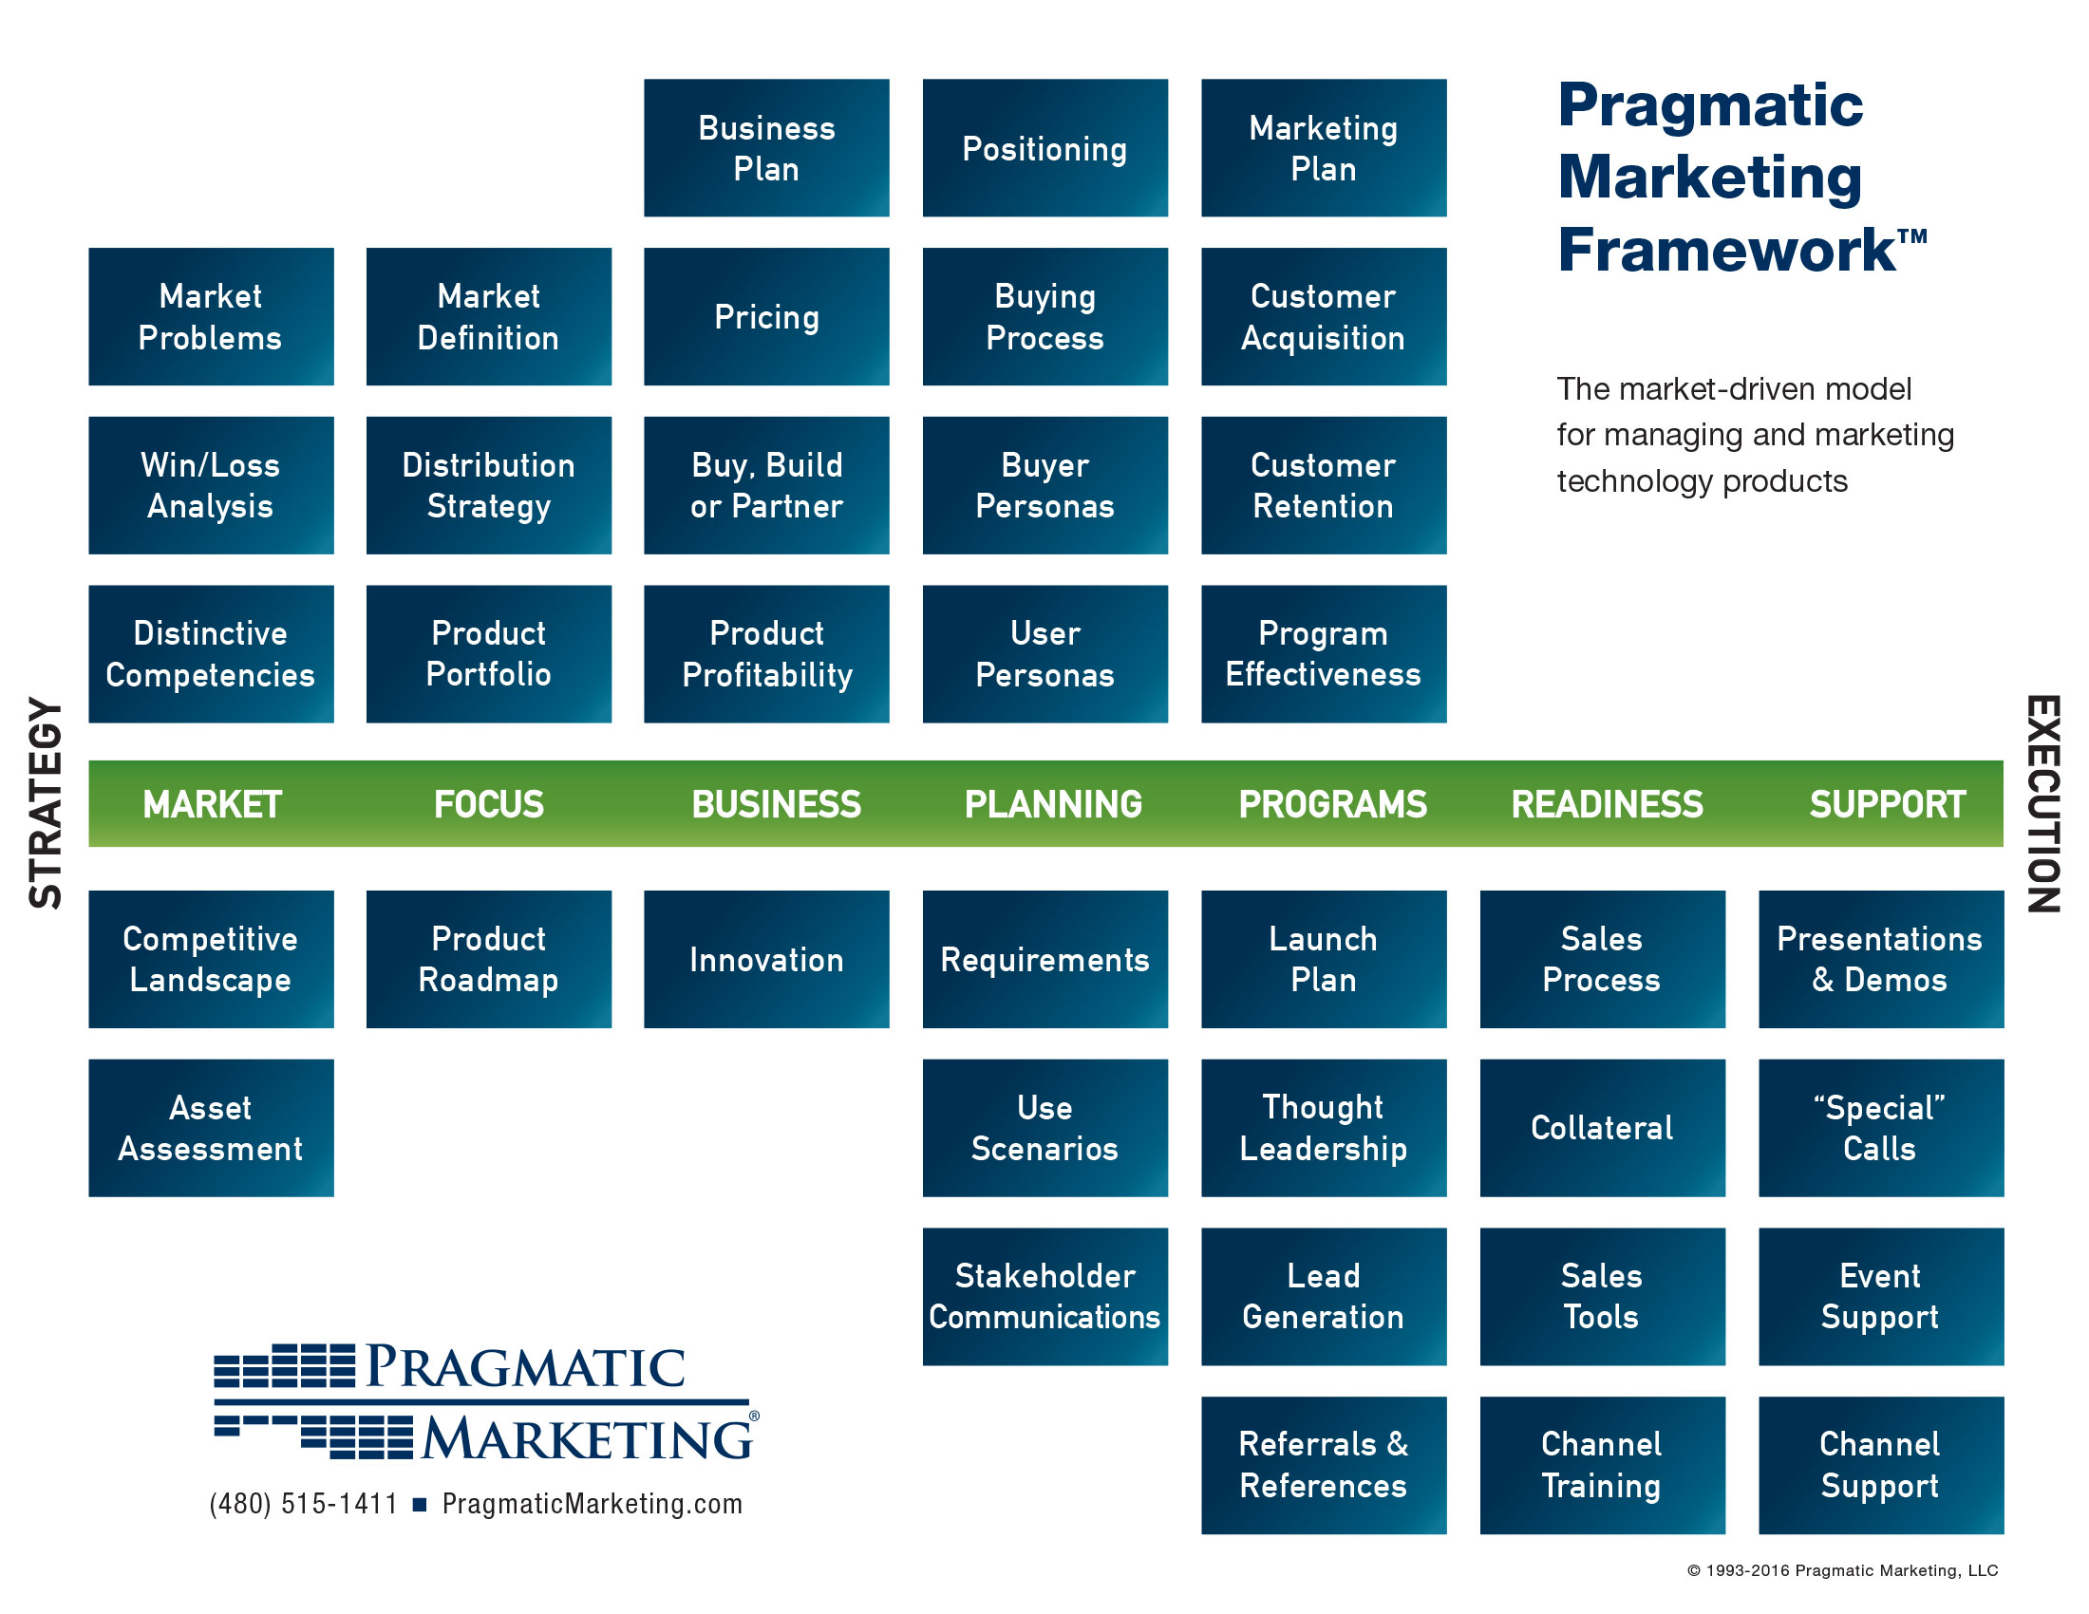
Strategic
Technical

Slide 4
Business Model
A business model
  Is a summary description (model) of how a business’ elements and their relationships interact to help the business achieve its strategic goals
  Example elements are products, partners, people, positions, etc. and example relationships are the processes that govern their interaction

Slide 5
Key
Activities
Customer Relationships
Key Partners
Customer Segments
Value
Proposition
Key Re-sources
Channels
Cost Structure
Revenue Streams

Slide 6
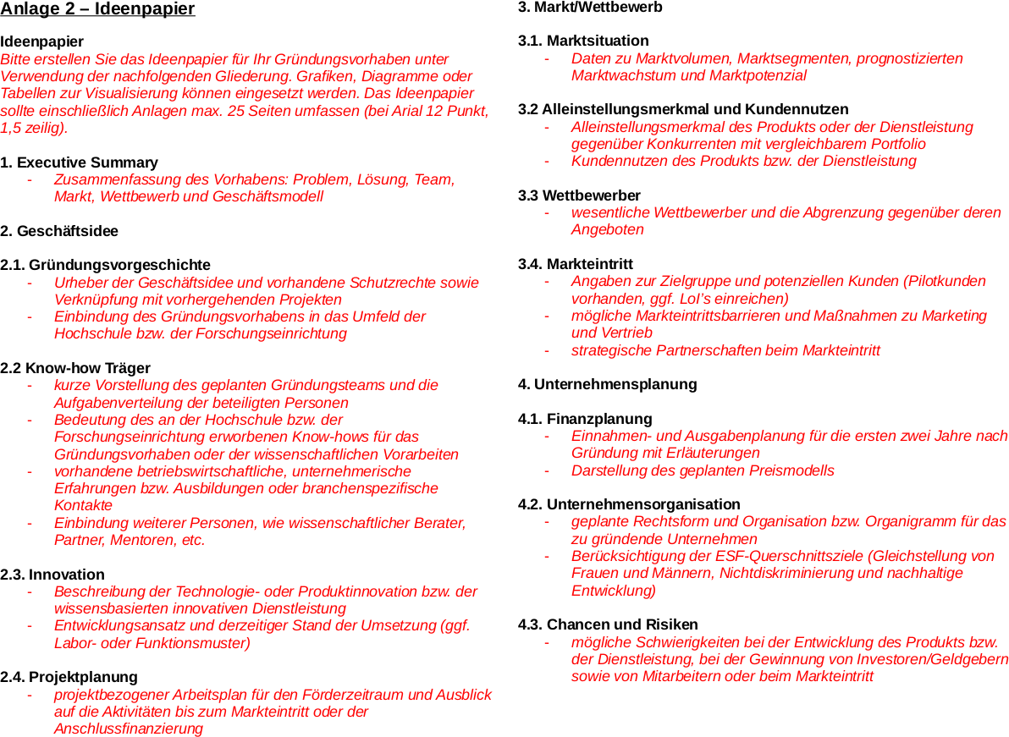

Slide 7
Marketing Requirements Document (MRD)
Basic product idea
Market and competition
Product architecture
Organizational planning

Slide 8
Basic Product Idea (MRD 1 / 4)
Product description
  Product vision
  Minimum viable product
  Unique intellectual property
Product roadmap
  Current / initial state
  First release
  Later releases
Strategic fit

Slide 9
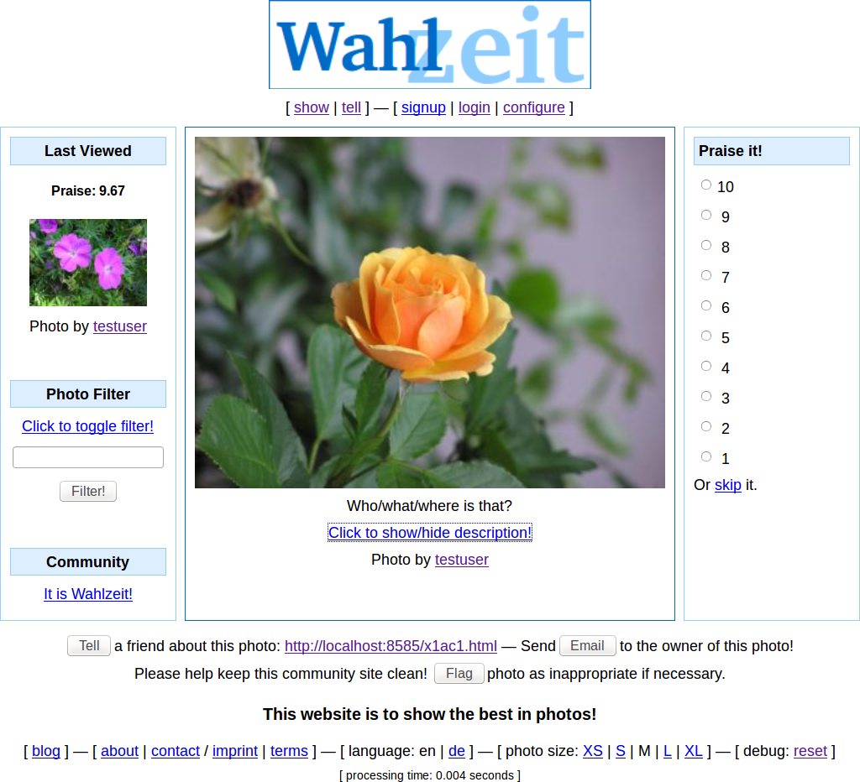

Slide 10
Agile / Scrum Product Vision
Product vision
  Captures the essence of the product and the reasons for its existence
    As the business value it provides to users
  Names users and customers
    Embodies the core structure of an underlying business model
  Is inspiring (inspires users / customers)
  Is timeless (not bound to a schedule)
  Is focused (reduces to the essentials)
  Is a decision aid (the ultimate arbiter)

Slide 11
Example Agile / Scrum Product Vision
Flowers Product Vision
The Flowers social network helps flower enthusiasts worldwide to connect with each other and enjoy following their favorite hobby online. Centered on showing and rating favorite flower photos, it inspires growing and presenting ever more beautiful flowers. With a highly engaged user community, Flowers is the best place for producers and sellers of gardening supply to reach out to customers and engage with them. Such engagement involves understanding flower enthusiasts’ needs around gardening supplies and selling to them.

Slide 12
Product Life-cycle
Maturity
Growth
Launch
Ideation and
Development
End-of-life

Slide 13
Product Roadmap
External Roadmap
  Overview-oriented; few details are provided
  Serves communication needs
  Serves external stakeholders
Internal Roadmap
  As detail oriented as needed (richer than external roadmap)
  Serves planning and communication needs
  Serves internal stakeholders

Slide 14
Example Product Roadmap
Minimal product
Runs on Linux stack
Deployable at cust#1 site
alpha
+ QA
beta
+ QA
start
alpha
beta
GA
2011-07-13
2012-03-30
2012-05-30
2012-07-30
time
Funding
Review
Integrates wazoo
Allows humpling
Runs on Windows
Meets accessibility reqs
Single-click installer
Meets new perf. reqs
Dingsbums compatible
v2.2
Cebit
v2.3
v2.4
Cebit
2013-04-15
2013-10-15
2014-04-15
time

Slide 15
Iteration Releases
Product release
  A deployable product increment
    That provides new significant business value to market / customer
Sprint release
  A demonstratable product increment
    That serves to gather relevant feedback from market / customer

Slide 16
Roadmap as Sequence of Releases
...
...
Release 1.3
New functionality
Release 2.0
New architecture
Release 2.1
Major bug fixes
2014-04-01
2014-10-01
2015-04-01
time
...
Rel. m-1
Rel. m
Rel. m+1
...
6-12 months
6-12 months
6-12 months
time

Slide 17
Product Vision vs. Roadmap vs. Release
 | Timeframe | Content | Certainty | (Responsible) Owner
Product Vision | Long-term (3+ years) | High-level ideas | Low | CEO and / or strategic product manager
Product Roadmap | Medium (1-5 years) | Themes and epics | Medium | Strategic product manager
Product Release | Short-term (months) | Epics and features | High | Technical product manager

Slide 18
(Agile) Product and Portfolio Management
Roadmapping
Annual goals
Annual goals
time scope
Release planning
Quarterly
goals
Quarterly
goals
Sprint planning
Team / Product
Department / Portfolio
Company
Organizational Scope

Slide 19
Market and Competition (MRD 2 / 4)
Market assessment
  Overall market size
  Market segmentation if applicable
  Addressable market
  Growth projection
  Pricing
Customer value
  Customer pain points
  Unique selling proposition
  Use cases and user personas
Competition
  Competitors
  Competing products
  Positioning and comparison
Market entry
  Barriers to entry
  First segment if applicable
  Pilot customers
  Partnerships
  Sales and marketing

Slide 20
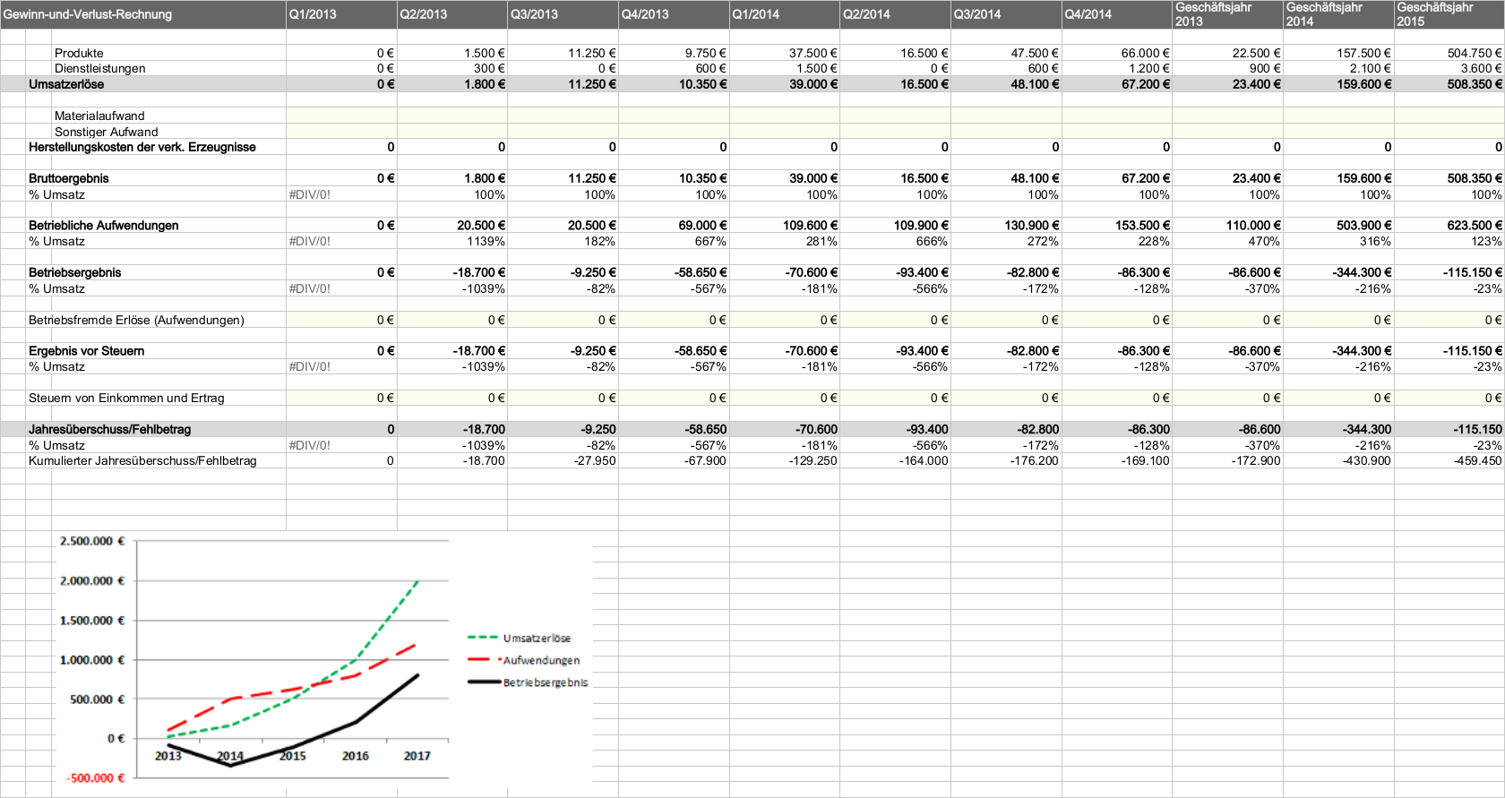

Slide 21
Product Architecture (MRD 3 / 4)
Hardware platforms, if any
Software platforms
Conformance with industry standards
Conformance with de-facto standards
Licenses and licensing

Slide 22

Product
Component
Component
Type
Component
Owner
Rights Sold
to Customer
Physical
Component
Product
Vendor
Property
Ownership
Program Code
(Source Code)
Software
Vendor
Usage Rights
(by EULA)
MP3 Patent
Fraunhofer IIS
Usage Rights
(by EULA)

Slide 23
MRD 4 / 4: Organizational Planning
Ability to execute
Risk assessment and mitigation
Financial planning

Slide 24
Review / Summary of Session
The Marketing Requirements Document (MRD)
  Basic product idea
  Market and competition
  Product architecture
  Organizational planning

Slide 25
Thank you! Questions?
dirk.riehle@fau.de – http://osr.cs.fau.de
dirk@riehle.org – http://dirkriehle.com – @dirkriehle
DR

Slide 26
Credits and License
Original version
  © 2012-2019 Dirk Riehle, some rights reserved
  Licensed under Creative Commons Attribution 4.0 International License
Contributions
  ...

